Slide 1
Product Profit Optimization Using a Linear Programming Model:
New Chemicals Company in Tire Manufacturing Industry
Hassan Ali, Ethan Norton, Jamia Russell

Slide 2


Problem Statement and Background
Company Mission
Background
CB Corporation wants to begin pilot scale production for their new R&D product formulations that they seek to sell to three prospective tire industry customers: Wheel Works, Tirevana, and Grip Gurus.
Increase customer engagement for future sales by delivering on price and performance targets
Maximize efficiency of labor and resources to products chosen for sale and keep in line with internal sustainability targets
Select products that will maximize short-term profit for business
Use Case:
CB Corporation
Problem
CB Corporation now needs to decide on what products are worth making and how much of the product to sell. They have a production trial week planned for the given sale period and two available sites ready for production.
Notes:
Hassan [1 Min]

Slide 3
Areas we explore
Research Questions
Will labor hours be a bigger constraint on site choice than inventory availability?
How many products will prove unprofitable and will not be sold due to low sale price and high raw material costs?
Can we sell or trade unused raw materials to gain more resources for profitable products?
What model solving method will be best for the decision problem?
How should we allocate or forecast resources in the future to maximize profit?
If we migrate this to a circular economy, how would that meet sustainability goals and further drive profit?
Notes:
Hassan [1 Min]

Slide 4

Literature Review: Similar Approaches
Product Mix Optimization
Model Simplicity vs Complexity
Advantages and Disadvantages of Literature Approaches
Notes:
Hassan [2 Min]

Slide 5


Literature Review: Alternative Approaches
Deterministic vs Stochastic Models
Linear Programming
Monte Carlo
Simulated Annealing
Notes:
Ethan [1 Min]

Slide 6
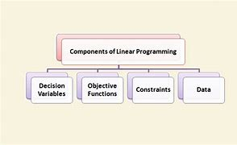
Literature Review: Model Applications
Complexity of Linear Programming Models
Interdependencies
Real-World Application
Notes:
Jamia [1.5 Min]

Slide 7



Model Implementation and Assumptions
168 hour constraint on labor per site
Material availability constraint max per site
Objective Function
R_{i} = Revenue (Product Sales Price) per Batch Unit of Product i (equiv. 15 kg)
C_{i} = Raw Material Cost per Batch Unit of Product i (equiv. 15 kg)
i = {P1, P2, P8*, P3, P4, P4*, P10, P6, P9}
j = {Site 1, Site 2}
m = {RSXX, STYY, CBAA, CBZZ, SBRXL, SLSM, C10, C20, C30, C40, C60}
Notes:
Ethan [1.5 Min]

Slide 8
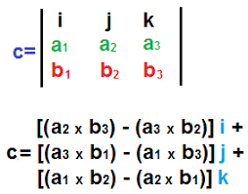
Methodology and Challenges
Cross-product calculated profitability of each material per product (cost is material level)
And then the profitability per product
Factors in an array of labor to produce each product
Factors in labor constraint per site
Solved utilizing GLPK
Notes:
Ethan [1 Min]

Slide 9
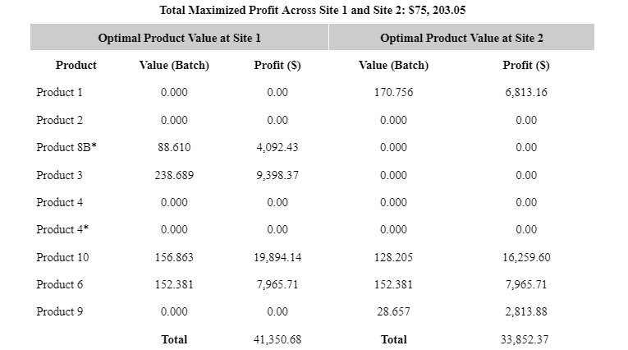
Computational Experiments and Results
Optimal Value
Trade Offs
Raw Material Use
Sensitivity Analysis
Unused Materials
Production System
Notes:
Jamia [3 Min]

Slide 10
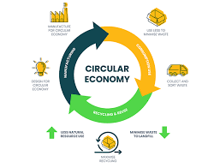
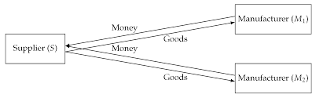
Model Limitations and Areas for Future Work
Circular Economy
Recycle
Waste Reduction
Cost Reduction
Resource Management
Forecasting
Storage and Transportation
Notes:
Ethan [1 Min]

Slide 11
Research Question Answers
Will labor hours be a bigger constraint on site choice than inventory availability?
The biggest constraint on site choice appears to be inventory availability
How many products will prove unprofitable and will not be sold due to low sale price and high raw material costs?
There are 3 products: Products 2, 4, and 4*
Can we sell or trade unused raw materials to gain more resources for profitable products?
Yes, including certain materials in the production plan contributes to suboptimality
What model solving method will be best for the decision problem?
Linear Programming Model
How should we allocate or forecast resources in the future to maximize profit?
Historical data should be used to forecast resource acquisition and allocation through quantitative models such as linear regression
If we migrate this to a circular economy, how would that meet sustainability goals and further drive profit?
By selling unused raw materials to other companies that need it
Notes:
Hassan [2 Min]

